Slide 1
Modulation For
Digital Telephone Lines
Subject Teacher : Prof. Manikrao Dhore

Slide 2
Our Group
Prashil Jambhulkar [ Roll No.: 02, Gr. No.: 11810849 ]
Sampatlal Jangid [ Roll No.: 03, Gr. No.: 11811238 ]
Siddharth Kale [ Roll No.: 13, Gr. No.: 11810562 ]
Shivprabhat Kadam [ Roll No.: 10, Gr. No.: 11811097 ]
Khushali Daga [ Roll No.: 17, Gr. No.: 11811215 ]

Slide 3
What is PCM

Slide 4
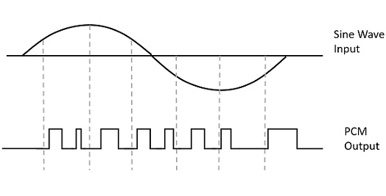
Definitions :
Pulse-code modulation (PCM) is a method used to digitally represent sampled analog signals. It is the standard form of digital audio in computers, compact discs, digital telephony and other digital audio applications. In a PCM stream, the amplitude of the analog signal is sampled regularly at uniform intervals, and each sample is quantized to the nearest value within a range of digital steps.

Slide 5
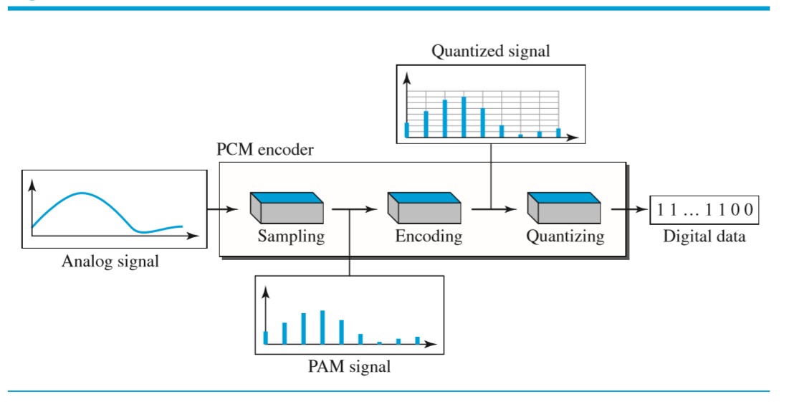
Block Diagram Of PCM:
Basics of PCM :
First we do Filtering and then Sampling i.e we convert Analog Signal into Discrete Signal
Then we do Quantization i.e we convert Discrete Signal into Digital Signal.
And finally, we do Encoding of this Digital Signal to get the Output in Binary.

Slide 6
Process Of PCM

Slide 7
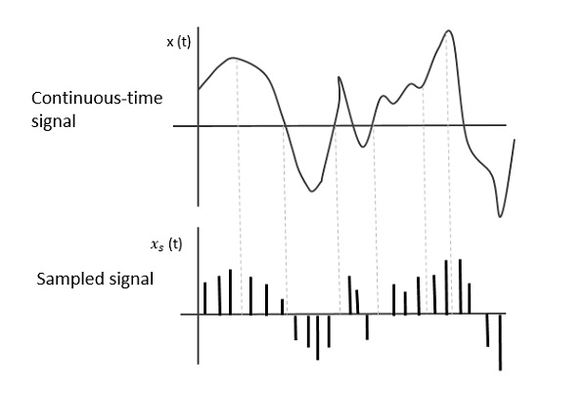
Sampling
Sampling is defined as, The process of measuring the instantaneous values of continuous-time signal in a discrete form.
There are three sampling methods
Ideal Sampling : An impulse at each instant
Natural Sampling : A pulse of short width with varying amplitude
Flat Top Sampling : A pulse of short width with fixed amplitude.

Slide 8
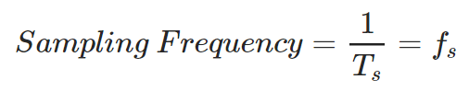
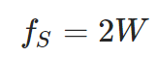
Mathematics Behind Sampling :
To discretize the signals, the gap between the samples should be fixed. That gap can be termed as a sampling period T_{S}.
For an analog signal to be reconstructed from the digitized signal, the sampling rate should be highly considered. The rate of sampling should be such that the data in the message signal should neither be lost nor it should get over-lapped. Hence, a rate was fixed for this, called as Nyquist rate (W : Max Fq.)
If the sampling rate is less than Nyquist rate then overlapping of information is done, which leads to mixing up and loss of information

Slide 9
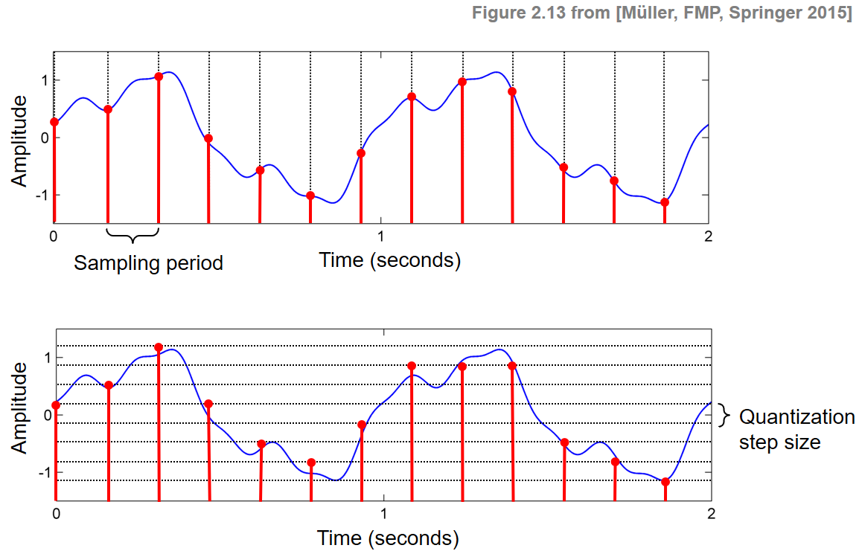
Quantization
The digitization of analog signals involves the rounding off of the values which are approximately equal to the analog values. The method of sampling chooses a few points on the analog signal and then these points are joined to round off the value to a near stabilized value. Such a process is called as Quantization.
Type :
Linear Quantization
Non - Linear Quantization

Slide 10
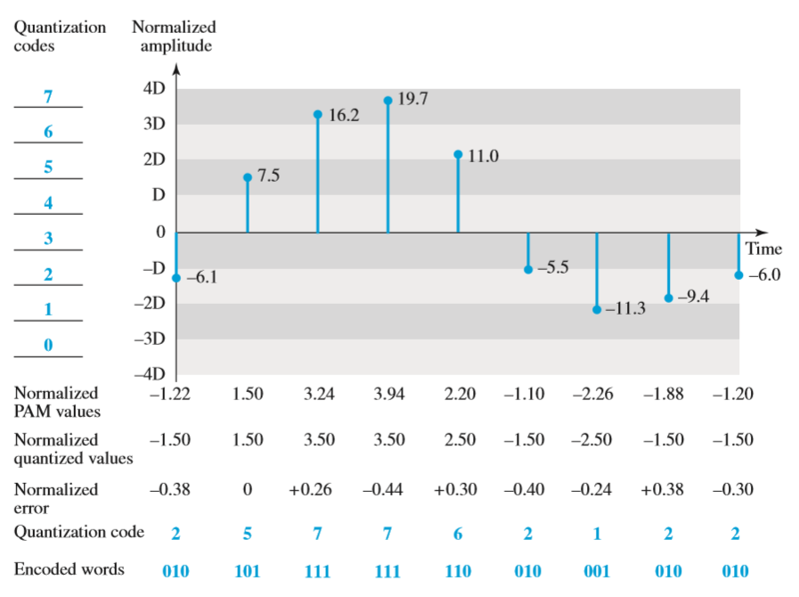
Summing up Everything Together

Slide 11
Perform PCM on 4 KHz Voice Frequency Analogue Signal (sinusoidal wave)

Slide 12
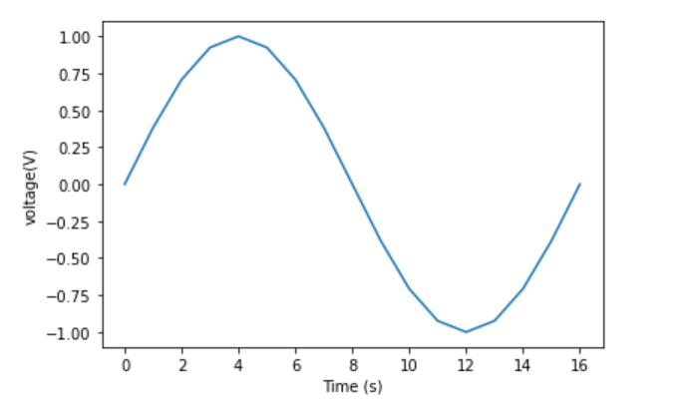
Step 1 : Filtering the Input Wave
We Use a Low Pass Filter here, Which would let pass only those frequencies which are less than the Threshold frequency, 4000 KHz in this case. In the case of our input we have an analog signal which has all frequencies less than the Threshold frequency hence the input and output waves are the same as there are no frequencies to be removed.

Slide 13
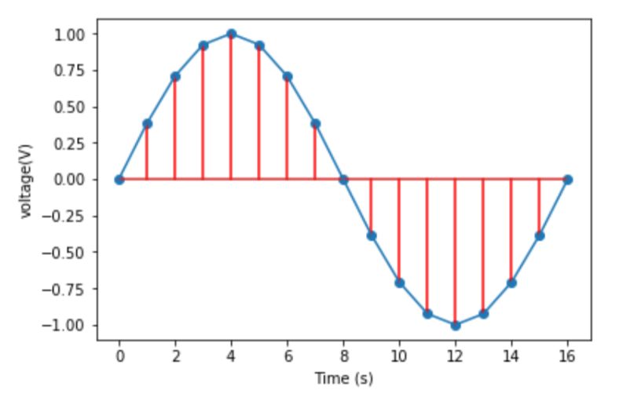
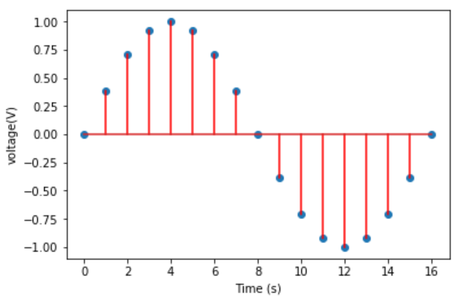
Step 2 : Sampling the Filtered Wave
After filtering the Analog Signal we then pass it through Sampling Block wherein we take the voltage levels at fixed interval of time. The math for Sampling is :
Sampling Rate >= 2 * Maximum Frequency ( Using Nyquist Theorem )
Hence : Our Sampling Rate >= 2 * 4000 ⇒ 8KHz, We choose the sampling rate to be 8 KHz.

Slide 14
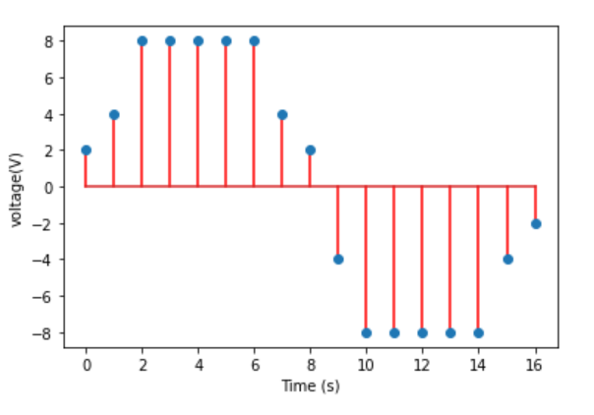
Step 3 : Quantizing the Sampled Wave
As now we have the Sampling of the Analog Signal, we can now
For telephone line there are 256 time slots. But we will decide to have eight levels L = 8
(Number of bits per sample) nb = log2(L) =log2(8) = 3

Slide 15
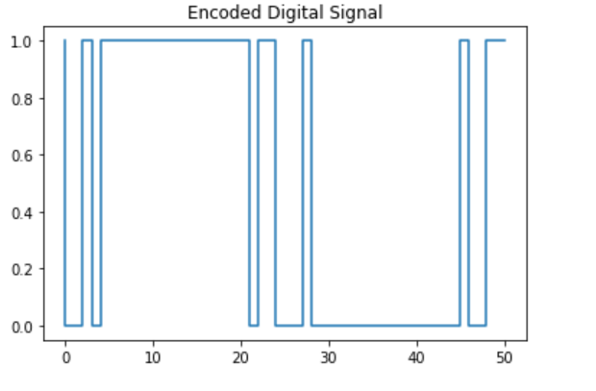
Step 4 : Encoding the Quantized Values
(Number of bits per sample) nb = log2(L) =log2(8) = 3
{-8 : [0,0,0], -6 : [0,0,1], -4 : [0,1,0], -2 : [0,1,1], 2 : [1,0,0], 4 : [1,0,1], 6 : [1,1,0], 8 : [1,1,1]}
Bit Rate = (sampling rate) fs X (number of bits per sample)nb = 8 × 3 = 24 KHz

Slide 16
Advantages Of PCM

Slide 17
Advantages
It is robust against noise and interference.
Uniform transmission quality.
Efficient SNR and bandwidth trade off.
It provides secure data transmission.
It offers efficient regeneration.
It is easy to add or drop channels.
Good performance over poor transmission path

Slide 18
Disadvantages Of PCM

Slide 19
Disadvantages
Overload appears when modulating signal changes between samplings, by an amount greater than the size of the step.
Large bandwidth is required for transmission.
Noise and crosstalk leaves low but rises attenuation.
An IDN (Integrated Digital Network) can only be realized by gradual extension of noise.
The difference between original analog signal and translated digital signal is called quantizing error in order to reduce this error we should increase level i.e bits

Slide 20
Thank You

